Slide 1

Day 5!

Slide 2
GSERM: Text Mining & NLP API Sources
Ted Kwartler

Slide 3

What is an API?
“Application Program Interface”
Clearly defined methods of communication between various software components.

Slide 4
JSON- Javascript Object Notation
Similar to R but used to make interactive objects in web browsers.
Respond in XML or JSON
Ask a question

Slide 5


Your phone doesn’t have every map in the world.
“Your phone requests information from the maps API services to render the information.

Slide 6
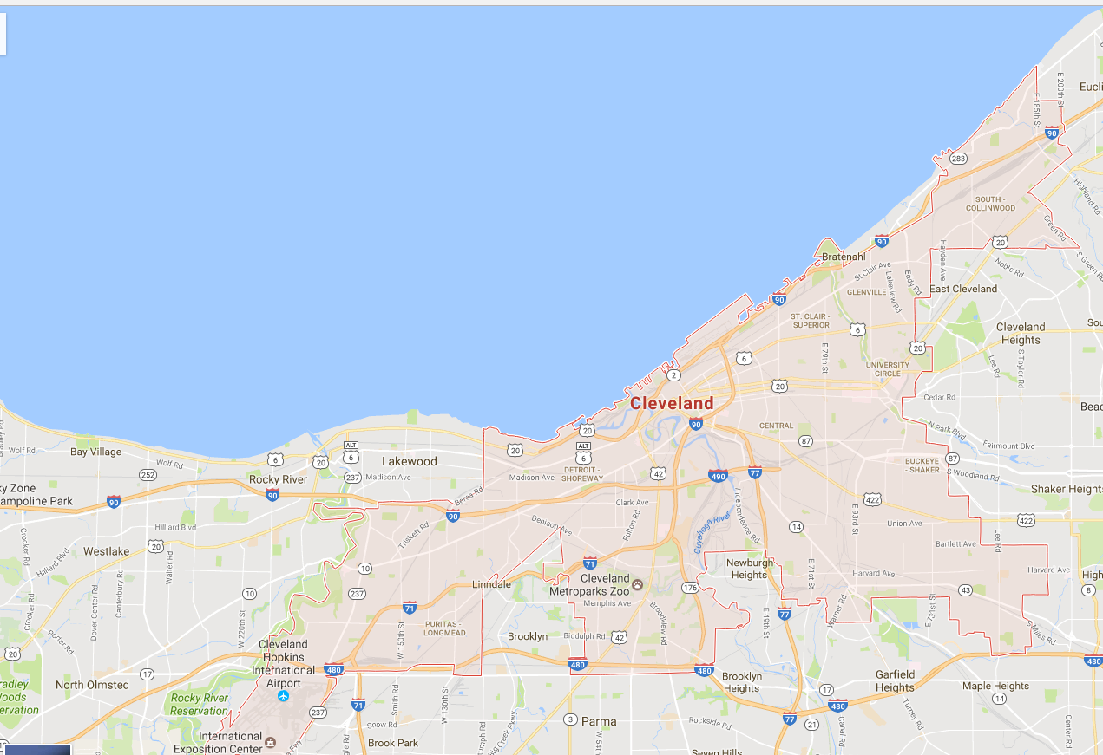
Your phone doesn’t have every map in the world.
www.google.com/maps/place/Cleveland,+OH/@41.4951143,-81.8462865,11z
Google Maps API Services include
Geocoding
Base map “tiles”
Basic Geographic Info

Slide 7
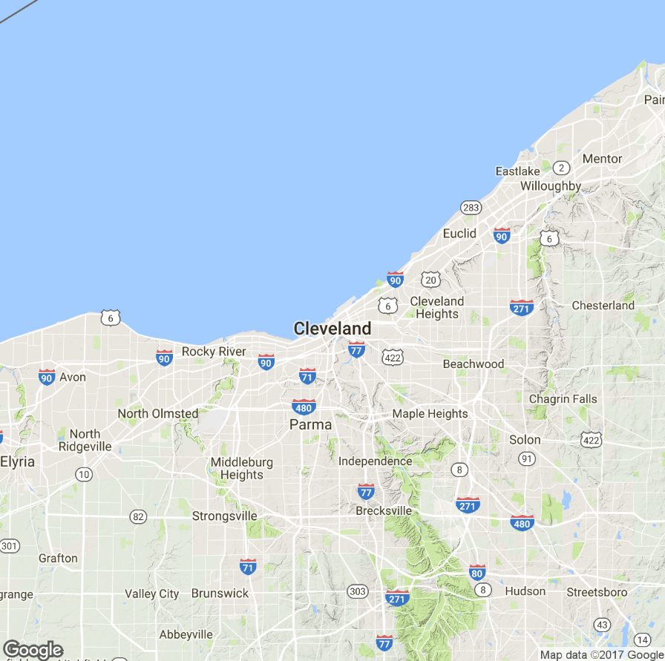
APIs are behind many of the sites you use everyday.
Static Map API
Static images are loaded as tiles underneath allowing you to scroll and navigate in your browser.

Slide 8
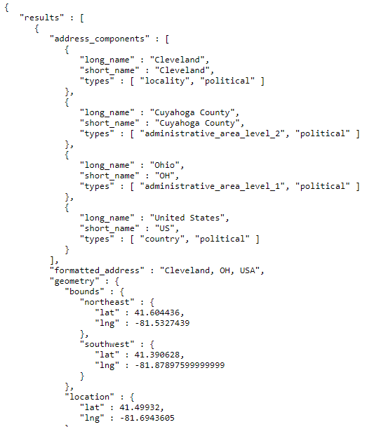
APIs are behind many of the sites you use everyday.
JSON Information API
On top of the tiles, more information is needed including the geo-political information and coordinates for the “bounding box”

Slide 9

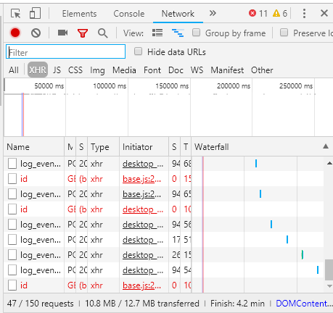
In chrome access the developer console.
While the video is playing, press F12 & reload the page.

Slide 10
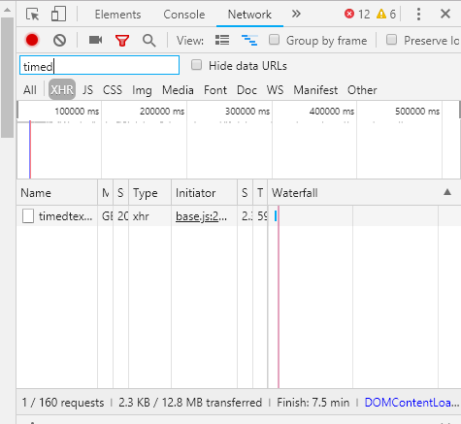
Click XHR and search for “timed” as in timedtext.
Right click on the request name and select “open in new tab”

Slide 11
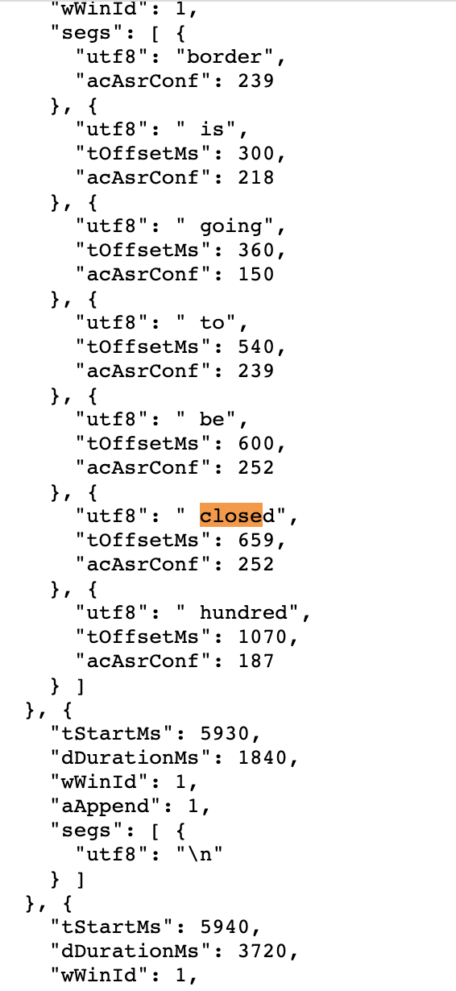
Closed Caption Data is in JSON

Slide 12

Now JSON
A_youtubeAPI_example.R

Slide 13
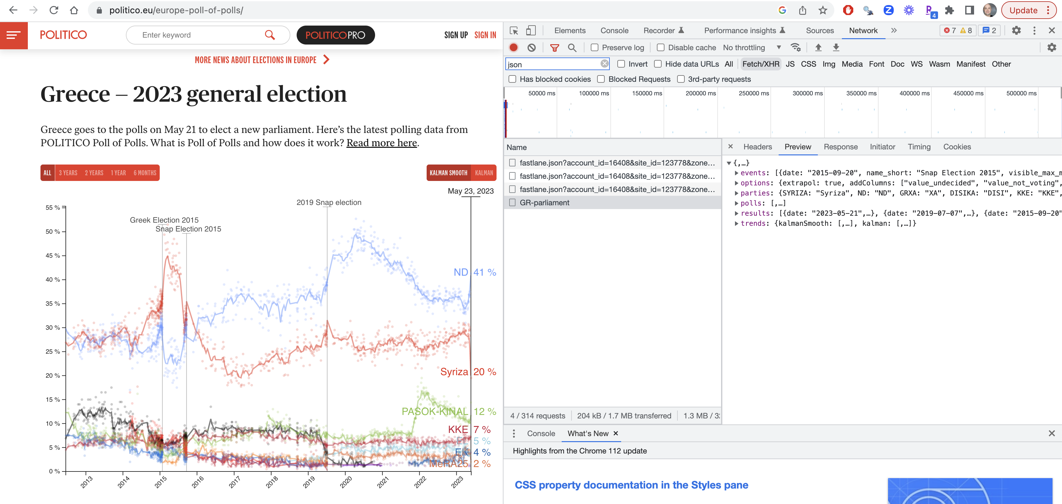
https://www.politico.eu/europe-poll-of-polls/

Slide 14
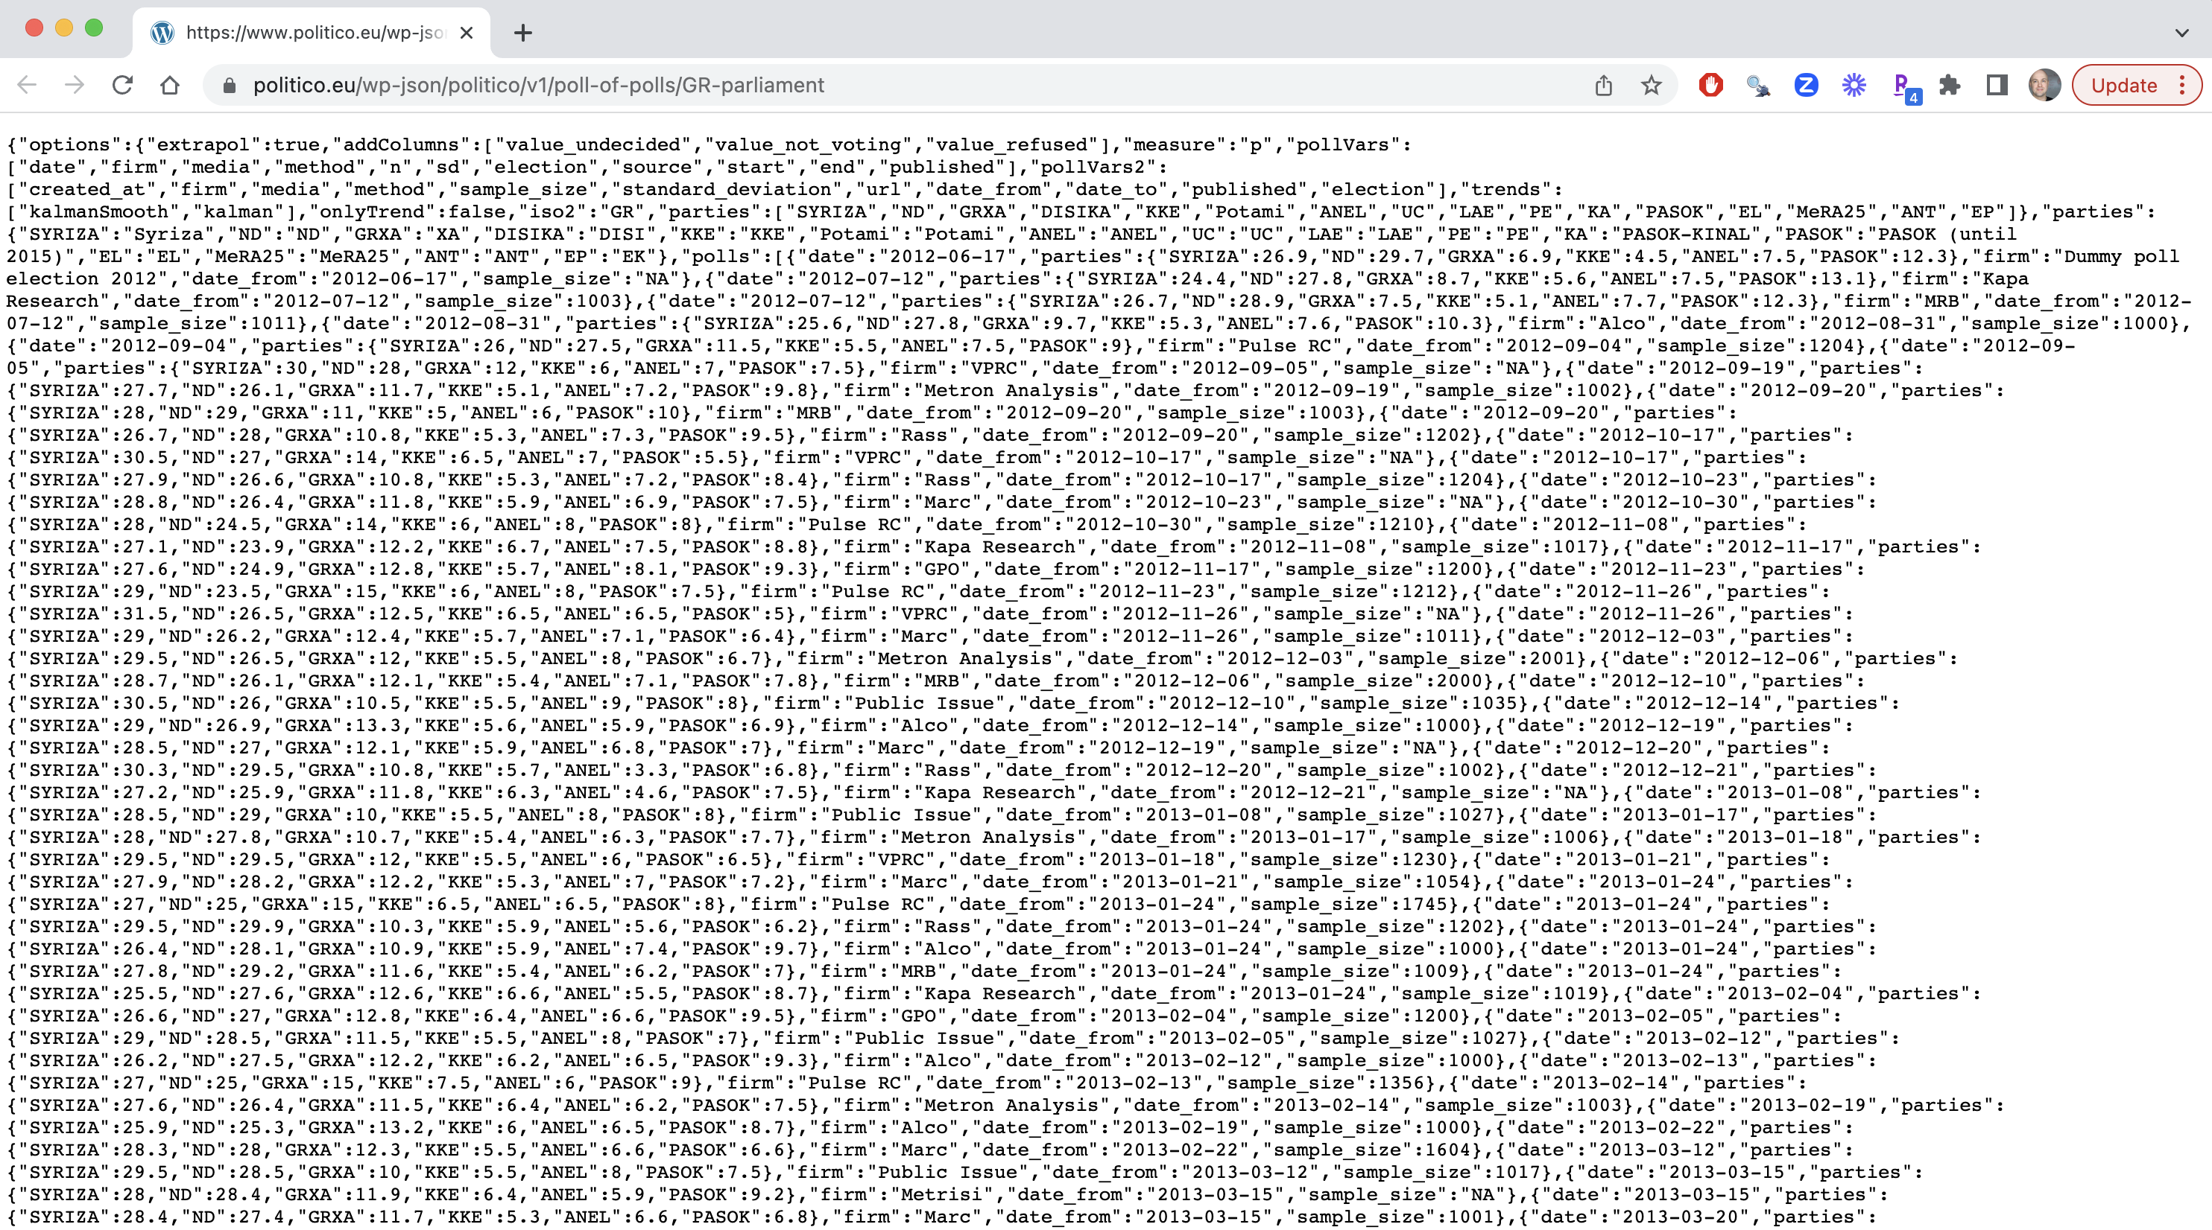
B_EU_politics_data.R
C_presidentApproval_example.R

Slide 15
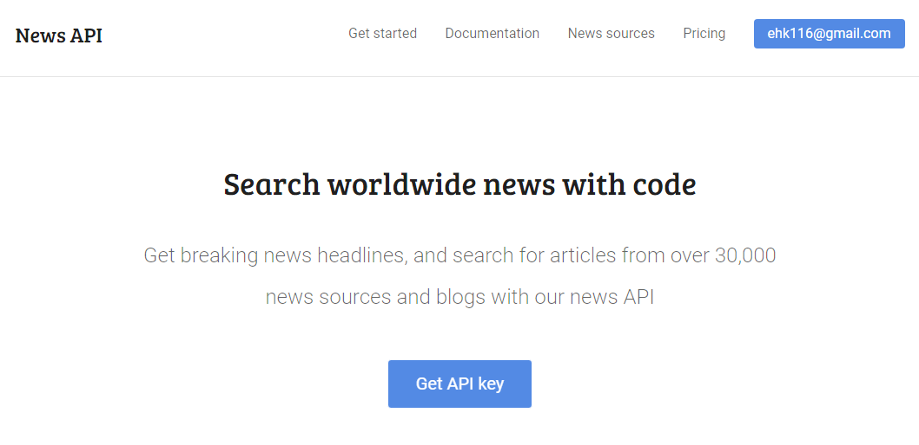
Appendix: A Simple JSON API
Sign up at https://newsapi.org/

Slide 16
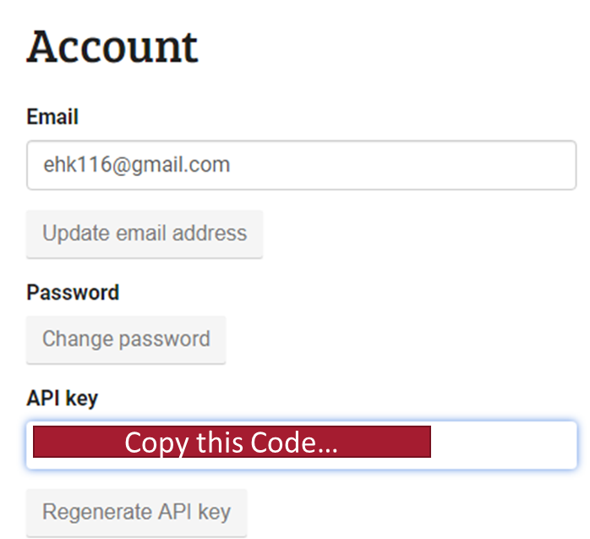

Some APIs require a “handshake” to authenticate

Slide 17
Other Straightforward APIs to Explore
If you work with social media data (requires signing up)
https://pipl.com/dev/demo
Sources of APIs to explore
https://nordicapis.com/13-api-directories-to-help-you-discover-apis/
https://github.com/toddmotto/public-apis

